Slide 1
NOTIFICATION OF PROPAGATING SOURCE CODE CHANGES AFFECTING USE CASES
ALPER SARIKAYA
SARAH GILLILAND
TOMISLAV PEJSA
Notes:
Quick reminder:
Goal of my project is to apply cartoon-style deformations to animated 3D characters using physics-based methods, and conduct a perceptual evaluation of these deformations.

Slide 2
Use Case
“A use case is the specification of a set of actions performed by a system, which yields an observable result that is, typically, of value for one or more actors or other stakeholders of the system.”

Slide 3
Save Document
Save Document Clicked
Save File Dialog
System boundary
Overwrite OK
Overwrite Cancel

Slide 4
Save Document
MainWindow:: btnSave_ Clicked
SaveFileDialog ::btnSave_ Clicked
System boundary
MessageBox:: btnOK_Clicked
MessageBox:: btnCancel_ Clicked

Slide 5
Scenario #1
Save Document
Tomislav
FileIO:: write()

Slide 6
Scenario #1
Save Document
COMMIT
Tomislav
FileIO:: write()

Slide 7
Scenario #1
Save Document
???
Tomislav
FileIO:: write()

Slide 8
Scenario #2
Save Document
Sarah
FileIO:: write()
Alper

Slide 9
Scenario #2
Save Document
Sarah
COMMIT
FileIO:: write()
Alper

Slide 10
Scenario #2
Save Document
UPDATE
Sarah
FileIO:: write()
Alper

Slide 11
Scenario #2
???
Save Document
Sarah
FileIO:: write()
Alper

Slide 12
Idea
Notify the programmer that a use case may be affected by a code change
Use case execution may be affected in non-obvious ways
Catch bugs early!

Slide 13
Approach
Programmer defines use cases as sets of method calls
MainWindow:: btnSave_ Clicked
MessageBox:: btnOK_Clicked
SaveFileDialog ::btnSave_ Clicked
MessageBox:: btnCancel_ Clicked

Slide 14
Approach
Build call graphs for each use case method
MainWindow:: btnSave_ Clicked
MessageBox:: btnOK_Clicked
SaveFileDialog ::btnSave_ Clicked
MessageBox:: btnCancel_ Clicked

Slide 15
Approach
Build call graphs for each use case method
SaveFileDialog ::btnSave_ Clicked
FileSystem:: checkFile Exists
MessageBox::create()
FileSystem::
writeFile()
FileIO::
open()
FileIO::
write()

Slide 16
Approach
Retrieve set of code changes from source control
FileIO.cpp : 85
SomeClass : 1715
FileIO.cpp : 345
FileIO.cpp : 96
SomeOther Class : 232

Slide 17
Approach
Determine call graph methods that have been changed
FileIO.cpp : 85
SomeClass : 1715
FileIO.cpp : 345
FileIO::write
FileIO.cpp : 96
SomeOther Class : 232

Slide 18
Approach
Find shortest paths connecting changed methods to use case methods
SaveFileDialog ::btnSave_ Clicked
FileSystem:: checkFile Exists
MessageBox::create()
FileSystem::
writeFile()
FileIO::
open()
FileIO::
write()

Slide 19
Approach
Show the user:
Affected use case
Affected method
Call graph path
Changed method
Save Document
SaveFileDialog ::btnSave_ Clicked
FileSystem::
writeFile()
FileIO::
write()

Slide 20
Implementation
yukon: Use Case-Oriented Code Change Notification Tool
yukon
Visual Studio Add-In
Use case definitions
Affected use cases + call graph paths
Doxygen
yukon cmdline tools
Git
Call graphs
Code changes

Slide 21
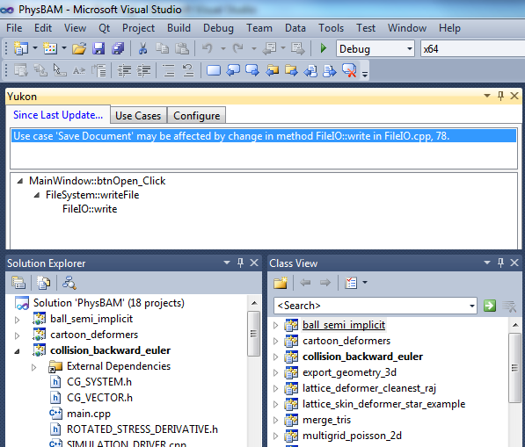
Visual Studio Add-In

Slide 22
Example
MLLib – small machine learning library
Use cases:
Load Data Set: MLLibCore::loadDataSet
Save Data Set: MLLibCore::saveDataSet
Train Bayes Net: BayesClassifier::train
Code changes:
ARFFDataSetIO::_readDataPoint
DataPoint::getEnumValue
DataPoint::setEnumValue

Slide 23
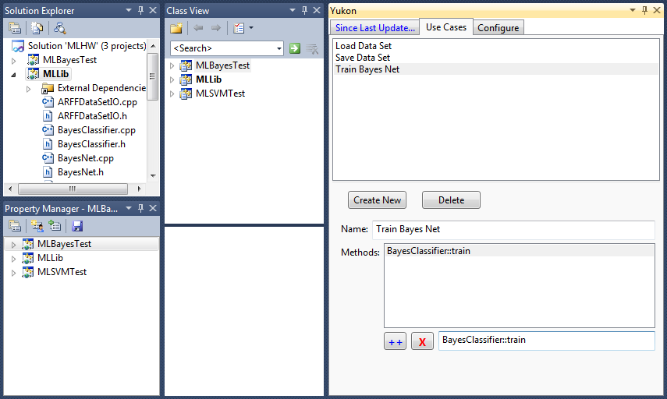
Example

Slide 24
Results
Use Case | Call Graph Path
Load Data Set | MLLibCore::loadDataSet → ARFFDataSetIO::read → ARFFDataSetIO::_readData → ARFFDataSetIO::_readDataPoint
Save Data Set | MLLibCore::saveDataSet → ARFFDataSetIO::write → DataPoint::getEnumValue
Train Bayes Net | BayesClassifier::train → BayesClassifier::_trainTAN → BayesClassifier::_computeMutualInf → DataPoint::getEnumValue

Slide 25
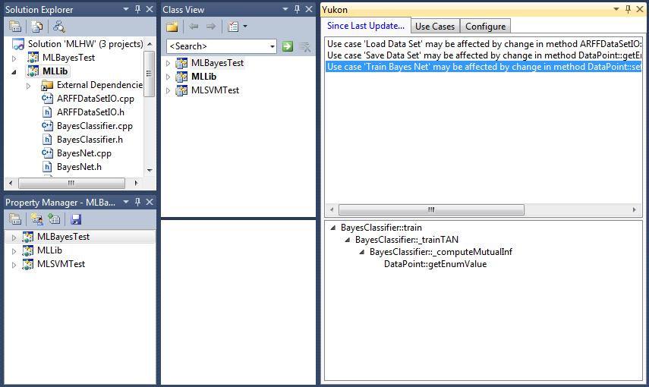
Results

Slide 26
Soundness vs. Completeness
Our method is complete, but unsound
If a method in the call graph has changed, our approach will find it
However, the code change may not be affecting execution of the use case

Slide 27

Limitations
Overapproximation due to call graph analysis
Better approach – static program slicing
Doxygen sucks for call graph generation
Just method name, can’t handle overloads...
Using regex to parse C++...
Proper evaluation needed!

